Slide 1

CAMPUS DASH
A project by THE NON-TOASTER MAKERS
Muhib Khan, Evan Nimmo, Mohammed Fawwaaz, Om Gaikwad, Mabon Ninan

Slide 2

Vision
Vision
Target audience: University of Cincinnati students
App for students who have difficulty obtaining food from dining halls during hard circumstances, such as bad weather or heavy workload
Students can order food through the website and have it delivered to their residence for the cost of a swipe and other charges
Solves the problem of students struggling to take care of their nutrition during midterms, finals, or final project season
Competitors are well-known food delivery companies that don't accept meal swipes
Eco-friendly delivery system using electric bikes/scooters, reduce carbon footprint.

Slide 3
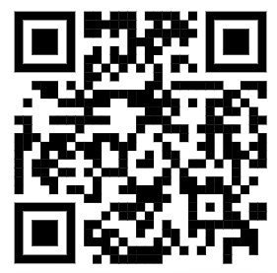
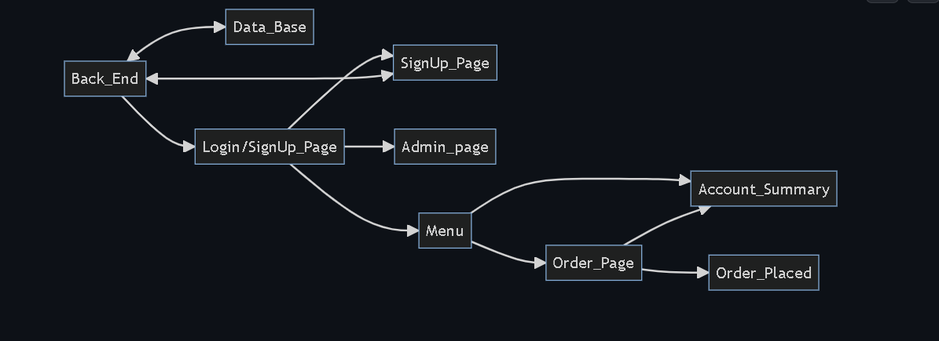
Software Architecture
The back-end consists of a web server, application server, and payment gateway.
The database stores all user and order information, as well as food items and their availability.
The login page allows users to authenticate themselves using their email and password, and the order page allows them to select food items and place an order.
The front-end for both pages will have client-side validation and order submission.

Slide 4
Vision
Challenges & Risks
Challenges:
Pipelining
Real-time updates
Integration with bearcat card
Steps to mitigate:
Effective communication of front and back-end teams.
Regular testing between the front-end and back-end can help identify and resolve any issues that may arise.
Implement real-time monitoring such as monitoring of network activity, etc.

